Slide 1



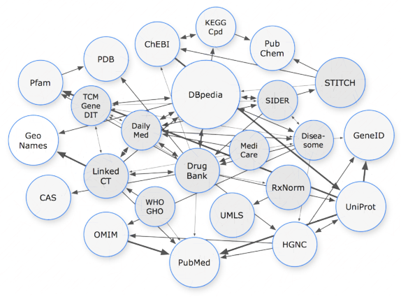





Pharmacist
3
Patient
2
4
Drug company
1
5
6
Researcher
Physician
Insurance company

